Slide 1

Wichita Metropolitan Statistical Area and Comparable Areas
Demographic and Economic Data

Slide 2

Introduction
The following presentation contains demographic and economic data for the Wichita metropolitan statistical area, which consists of Harvey, Sedgwick, Butler and Sumner Counties. For comparison purposes it also contains data on the four metropolitan areas that are most similar to Wichita in both demographic characteristics and industrial mix.

Slide 5
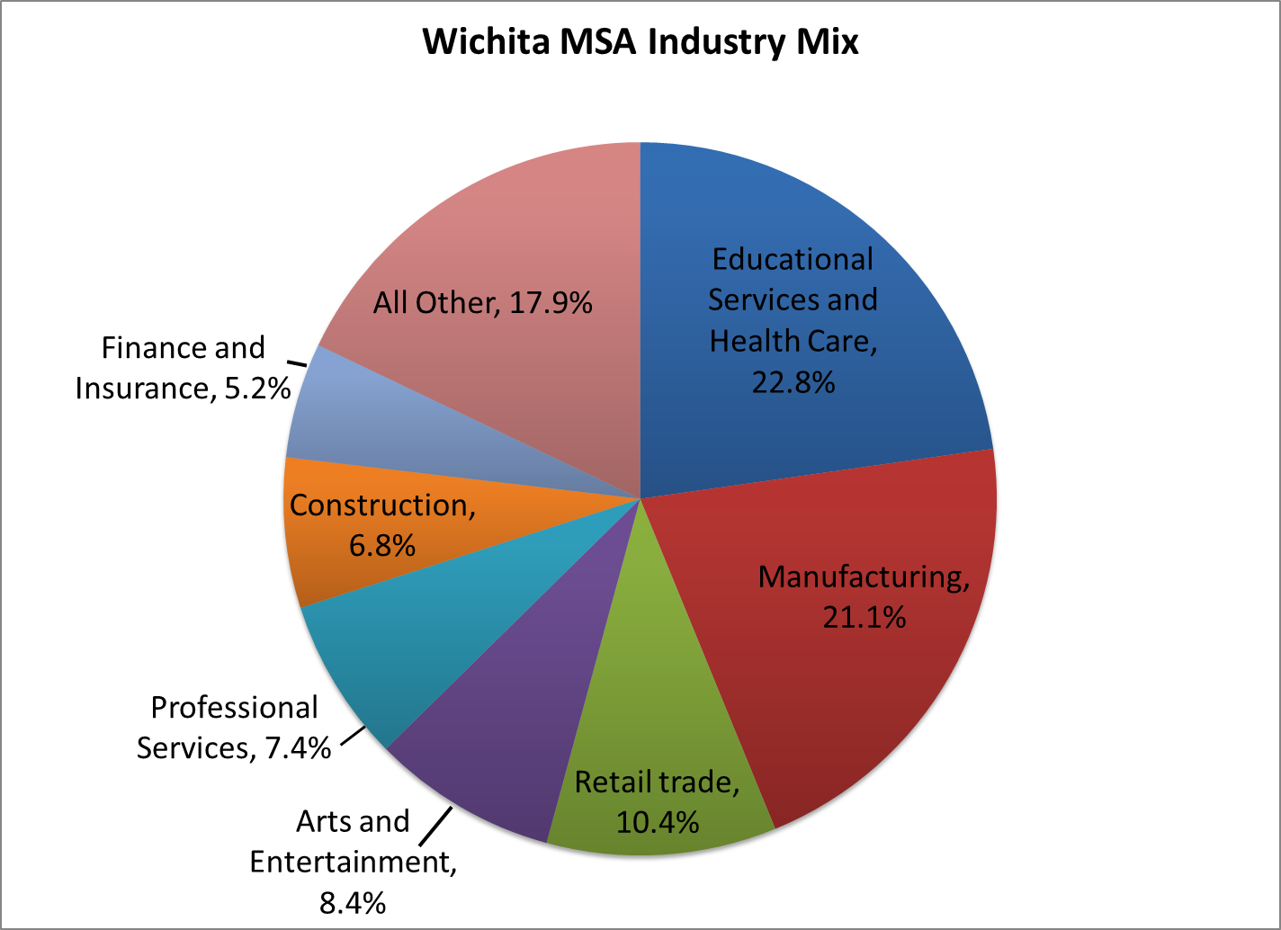
Source: American Community Survey, 3-year Estimates 2008-2010

Slide 6
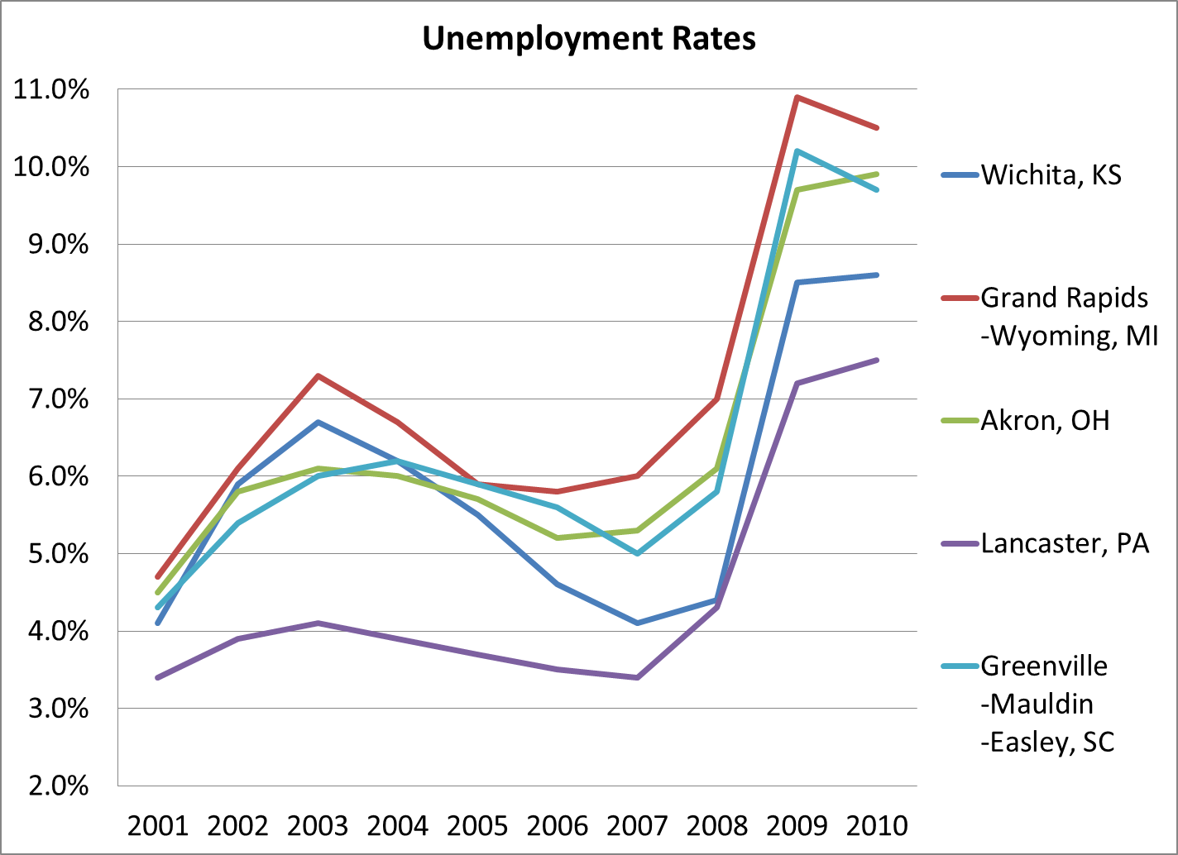
Source: Bureau of Labor Statistics

Slide 7
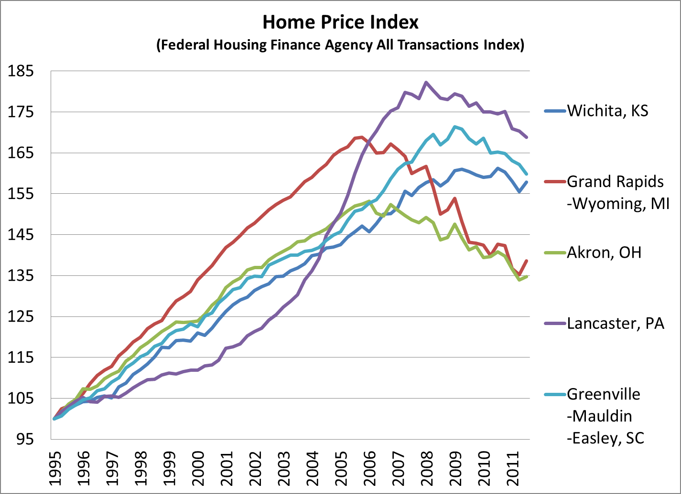
Source: Federal Housing Finance Agency

Slide 8
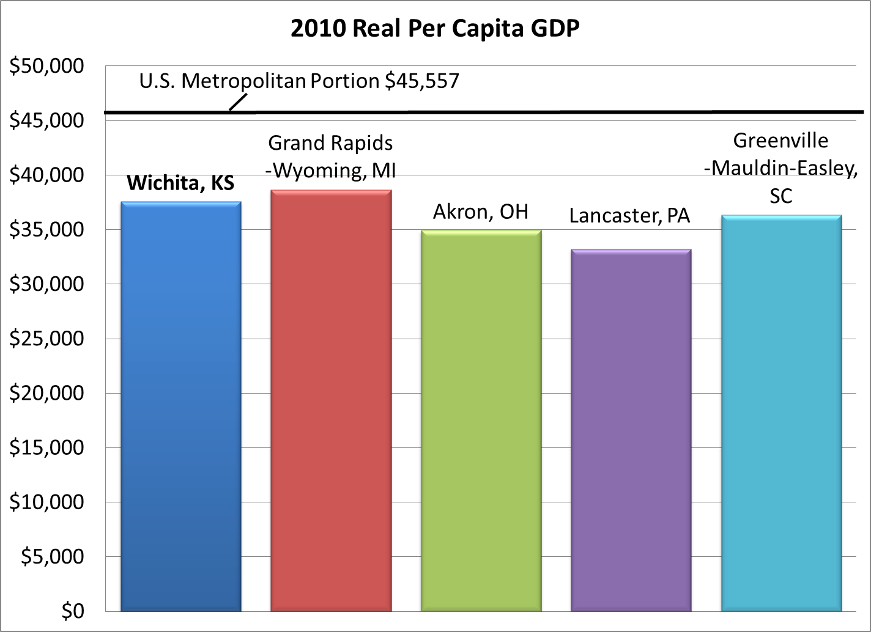
Source: Bureau of Economic Analysis

Slide 9
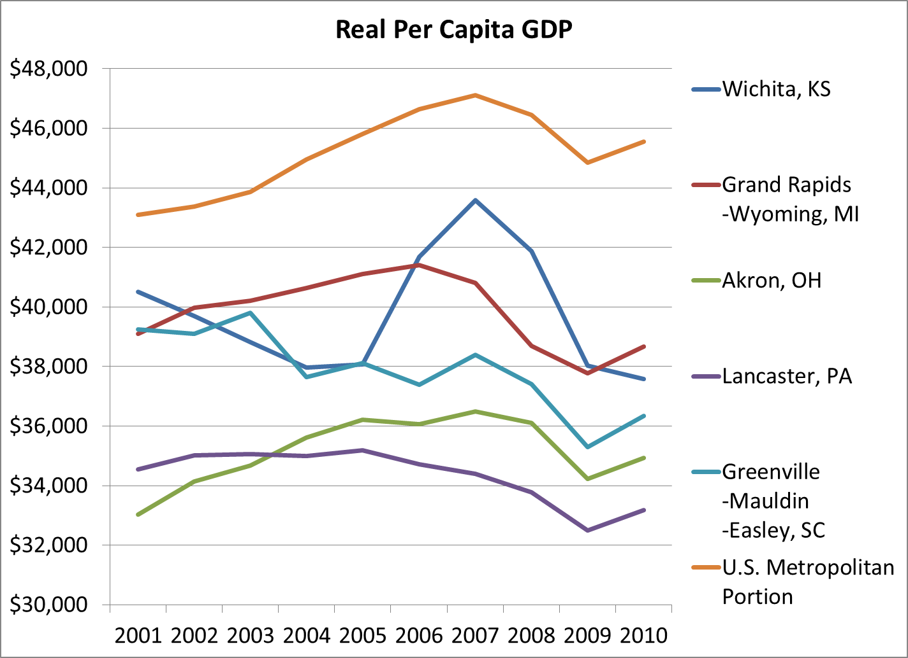
Source: Bureau of Economic Analysis

Slide 10
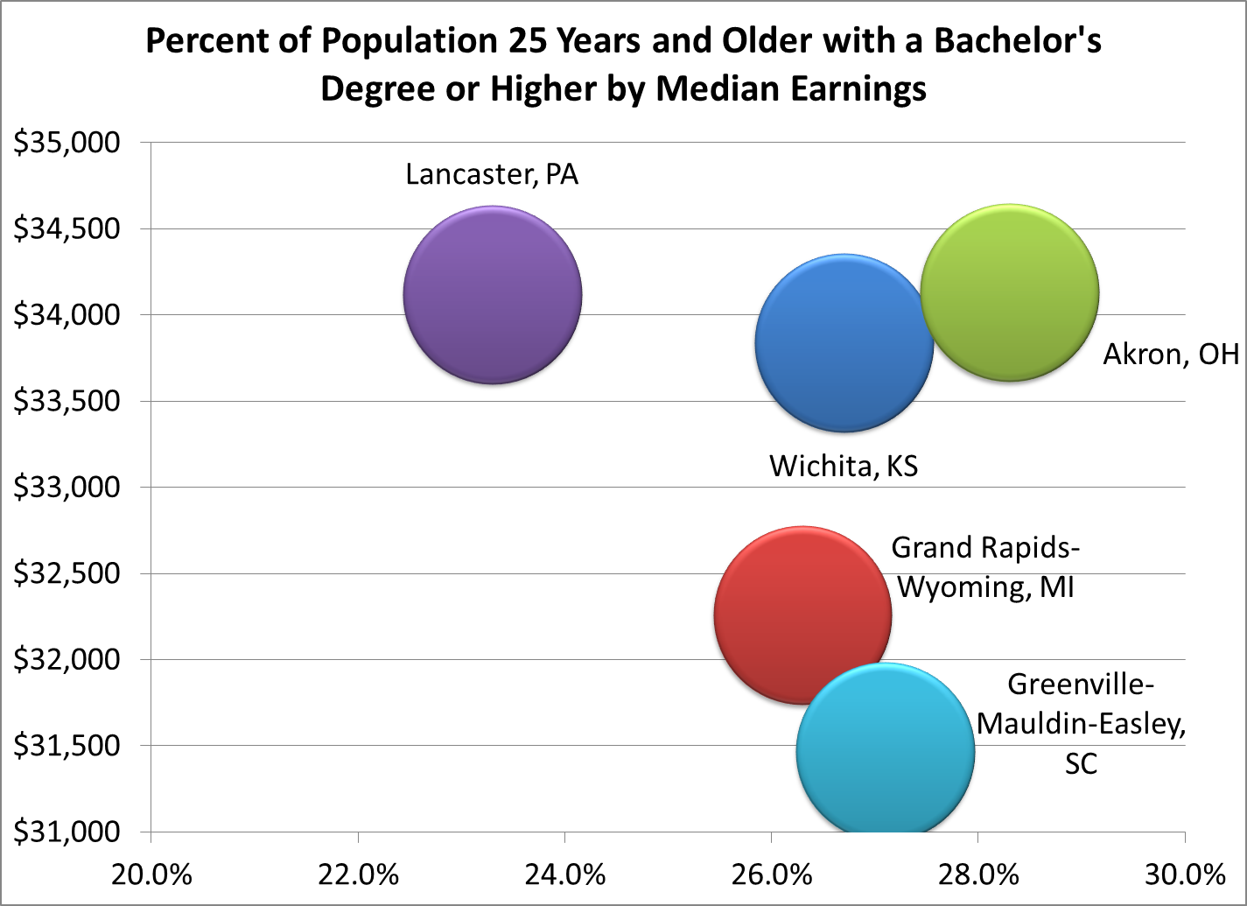
Source: American Community Survey, 5-year Estimates 2006-2010

Slide 12
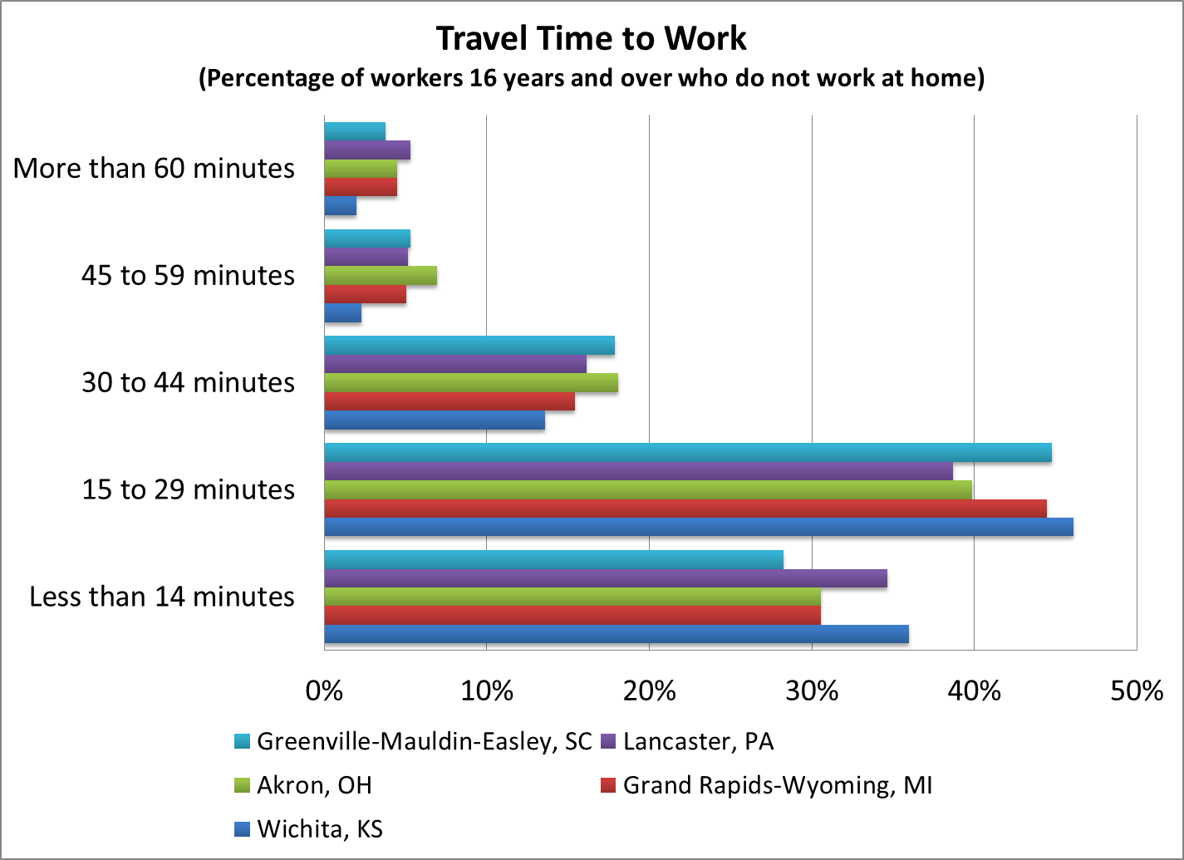
Source: American Community Survey, 3-year Estimates, 2008-2010

Slide 14
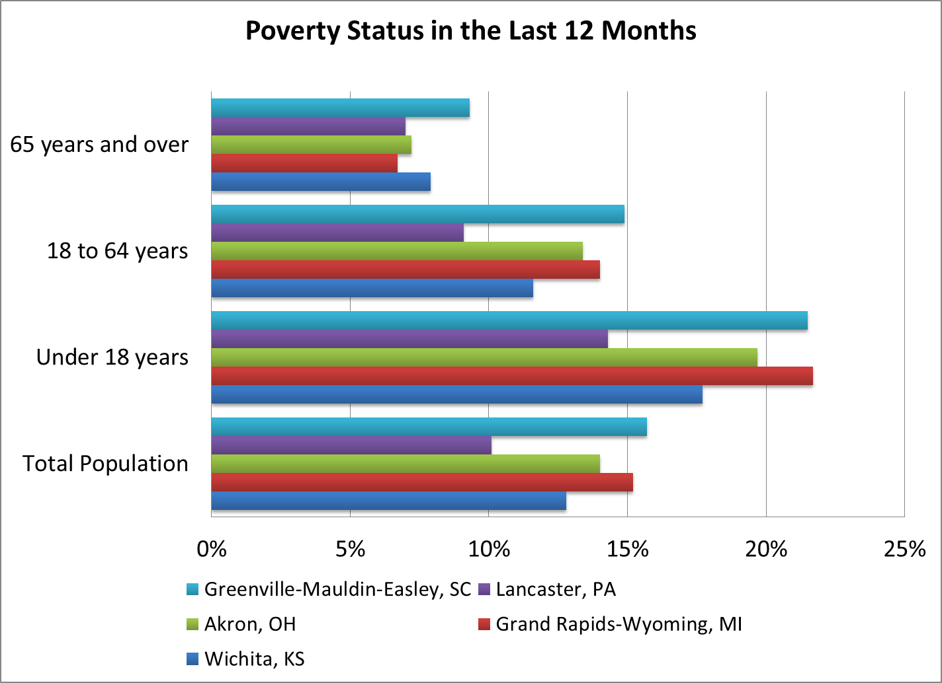
Source: American Community Survey, 3-year Estimates, 2008-2010

Slide 16

Thank You
For additional information you may contact us at: (316) 978-3225

